Slide 1
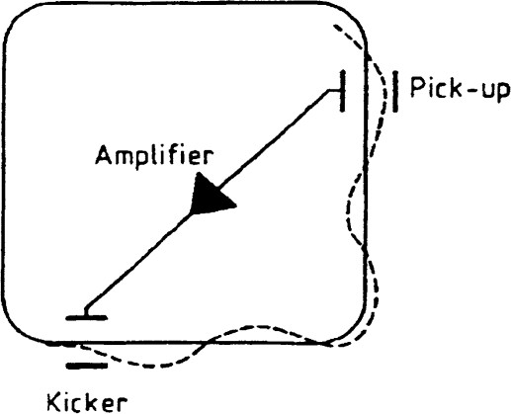
Stochastic cooling- Model Explanation
Stochastic cooling model – Time domain picture, simulating filter cooling
Beam of particles with a Gaussian distribution on (mean=0, standard deviation=1)
on x(position) and x’(angle) for transverse coordinates.
Longitudinal coordinates tau and dp/p : Gaussian distribution * 10⁻⁴
for momentum spread and uniform distribution (-Th,Th) for tau for
longitudinal coordinates, where 2*Th → simulation window
No elements on the ring, just an empty ring with a pickup and a kicker with
a specified one-turn phase advance and phase advance between PU and kicker
Response functions: In order to apply a more realistic kick, we introduced longitudinal and transverse response functions, as general response functions from all the electronics. Specifically,

Slide 2
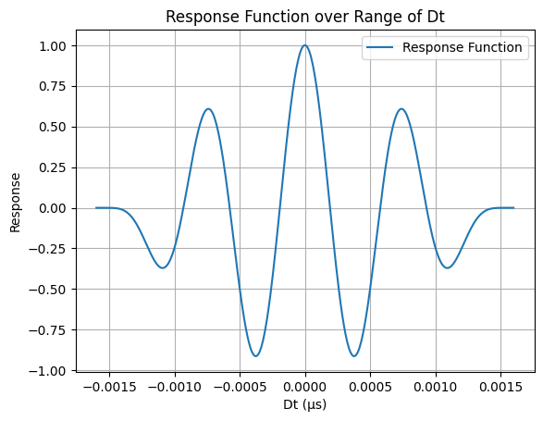
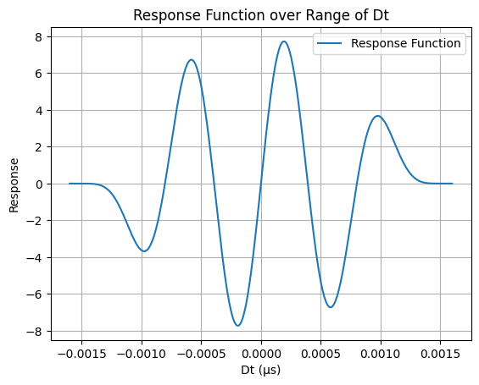
Stochastic cooling- Response functions
Tranverse
Longitudinal

Slide 3
Stochastic cooling- Model Explanation(2)
Mixing: In order to account for mixing, we introduced eta (η: slip factor) parameters: ηpu->K=-0.01 ( eta from PU→K), ηK->PU=-0.01 ( eta from K → PU) (below transition) -> close to the actual values of the AD. Change taus twice per turn(once in the pickup and once in the kicker ) -> Tau + eta*dp/p*Trev , where Trev=revolution period. Changing taus -> mixing!
Slicing: Edge effects -> particles at the edges of the simulation window will see only contributions of particles from one direction -> beam into 2 slices(early and late slice) -> rearranging particles twice per turn(once on PU and once on K) based on their taus (early slice → particles with taus (-Th → 0), late slice → particles with taus(0→ Th)) . Also speeding up the simulation.
Kick: Three slices of the beam(one before the time window under investigation, one after and the slice under investigation) -> calculation of the contribution of each particle on each of the time traces (samples) in the signal using many samples (800-2000) -> add contribution of each particle to time trace(sample) -> create a signal from time traces -> kick based on this signal. In order to account for the edge effects -> overlapping region, which we use to extend the signal -> Toverlap=4*sigdelt*(etaPUK + etaKPU)*Trev), where sigdelt=0.0001→ sigma of dp/p from the gaussian distribution. Creation of one signal per slice -> used to calculate the kick that on each particle based on its tau. Toverlap is defined such as to include even the slowest or the fastest particles.

Slide 4
Stochastic cooling- Model Explanation(3)
The number of samples on the time traces is defined at the beginning of the simulation as well as the gains, the twiss parameters, the etas, number of particles and turns, the sigma of dp/p, the phase advances and the overlap region.
No electronic noise for the time being.
From the traces of all particles that fall into the time window of the response function we calculate signalL and signalH!
Transverse correction→ angle-gainH*signalH(tau of particle)*position_of_particle -> tranverse kick, where gainH=transverse gain
For longitudinal correction we apply filter cooling i.e. we keep the previous longitudinal signal and from that we substract the current one. The result is used for the longitudinal kick.
Longitudinal correction → dp/p-gainL*(signalLprevious(tau of particle)-signalLcurrent(tau of particle)) -> (longitudinal kick, filter cooling), where gaiL= longitudinal gain

Slide 5
Stochastic cooling- Parameters
Parameter | Value
betPU,betK | 1.3 , 0.8
alfPU,alfK | -0.9 , 0.6
muPUK, total angle | 1.51, 2*π*1.34
etaPUK, etaKPU | -0.01, -0.01
sigdelt | 0.0001
Th, Trev | 0 .1e-6, 5.0e-6
GainH,GainL | 15e-7, 5e-7
Nsamp, DTSamp | 800, Th/NSamp
Toverlap | 4*sigdelt*abs(etaPUK + etaKPU)*Trev
Nparts, Nturns | 1500, 12000
BetPU, betK, alfPU, alfK -> twiss parameters at the location of the pickup and the kicker -> from these we calcualte gamPU, gamK
muPUK -> phase advance between pickup and kicker
Total angle -> one-turn phase advance
etaPUK, etaKPU -> slipping factor from pickup to kicker and visa versa
Sigdelt -> momentum deviation
Th -> simulation window, we are using this to define the taus of the particles
Trev-> revolution period
GainH,gainL -> transverse gain, longitudinal gain
Nsamp -> the number of samples we are using when we define the signal
DTSamp -> time step of every sample
Toverlap-> overlapping time region between consecutive signals
Nparts -> number of particles
Nturns -> number of turns
Calculation of emittance and momentum spread:
RMS emittance:
Geometric emittance :
(calculated on pickup)
RMS momentum spread: δ: dp/p

Slide 6
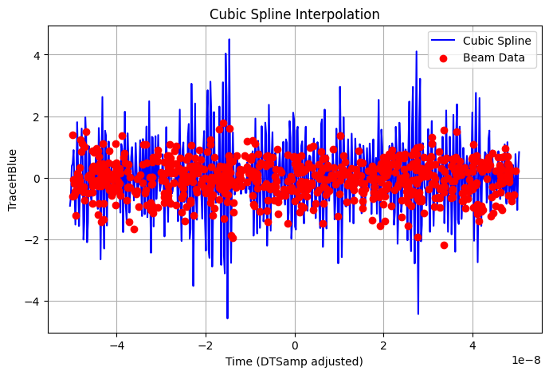
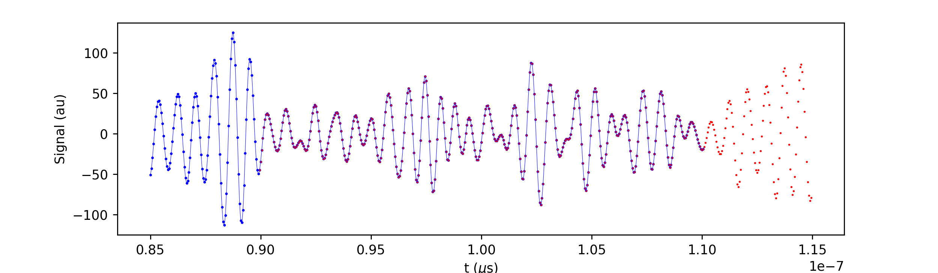
Stochastic cooling- Typical signals
A transverse signal from one slice of the beam(blue) with the particles’ positions on red dots. The signal is created using cubic spline interpolation.
Two longitudinal signals side by side (blue and red). These 2 signals are from 2 consecutive slices of the beam. We can clearly see the overlapping regions.

Slide 7
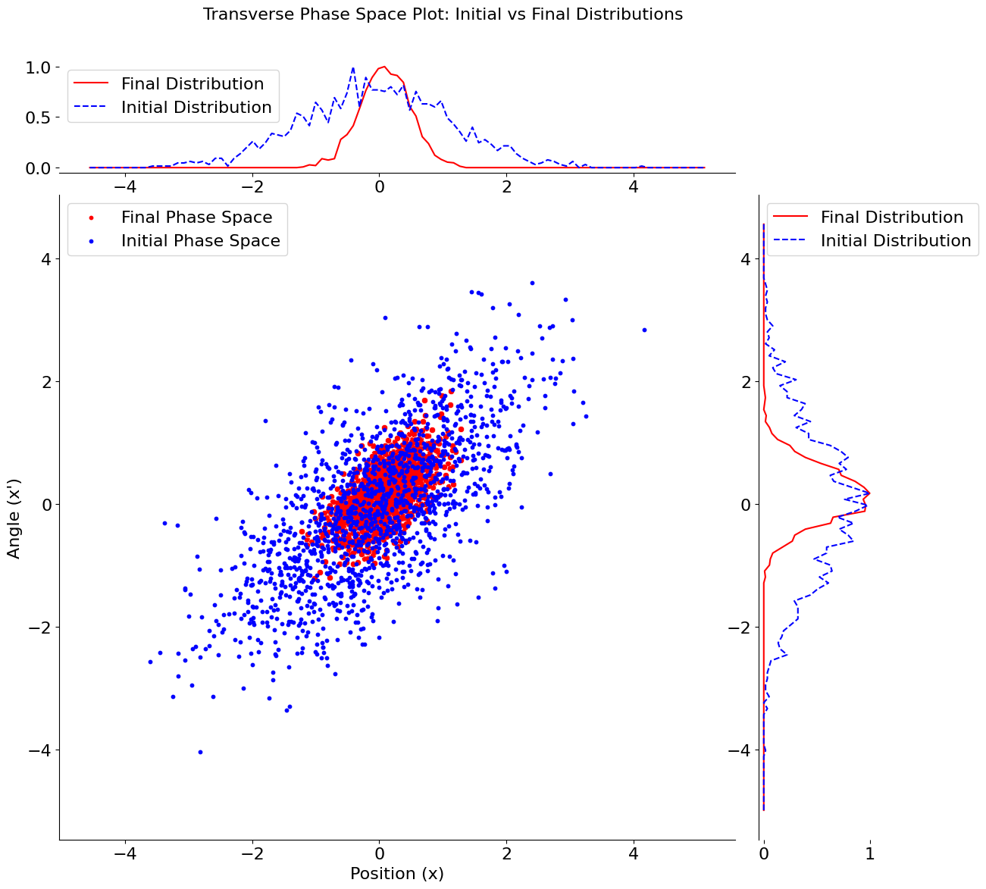
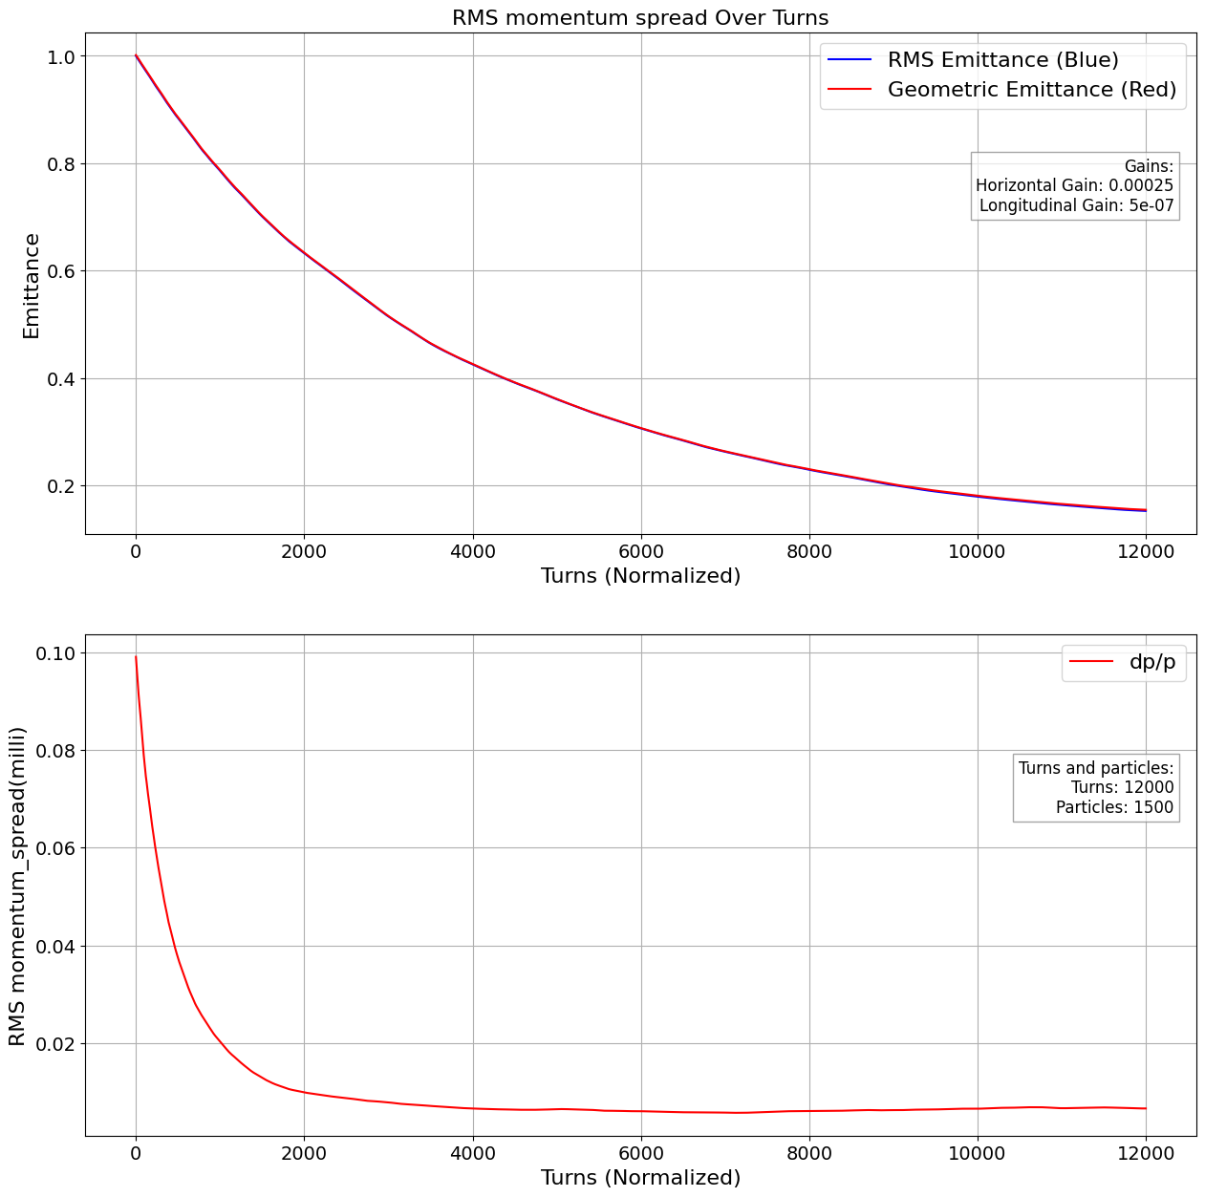
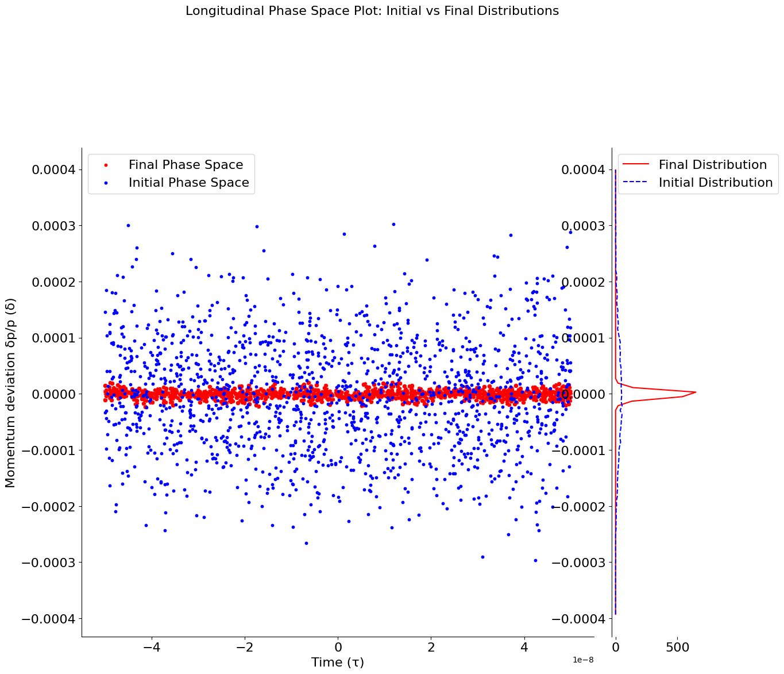
Stochastic cooling-Some results → good case
Emittance is reduced by 80.85% rms_momentum_spread is reduced by 93.83%
Transverse Gain = 2.5e-04, Longitudinal gain= 5e-07, turns=12000, particles=1500

Slide 8
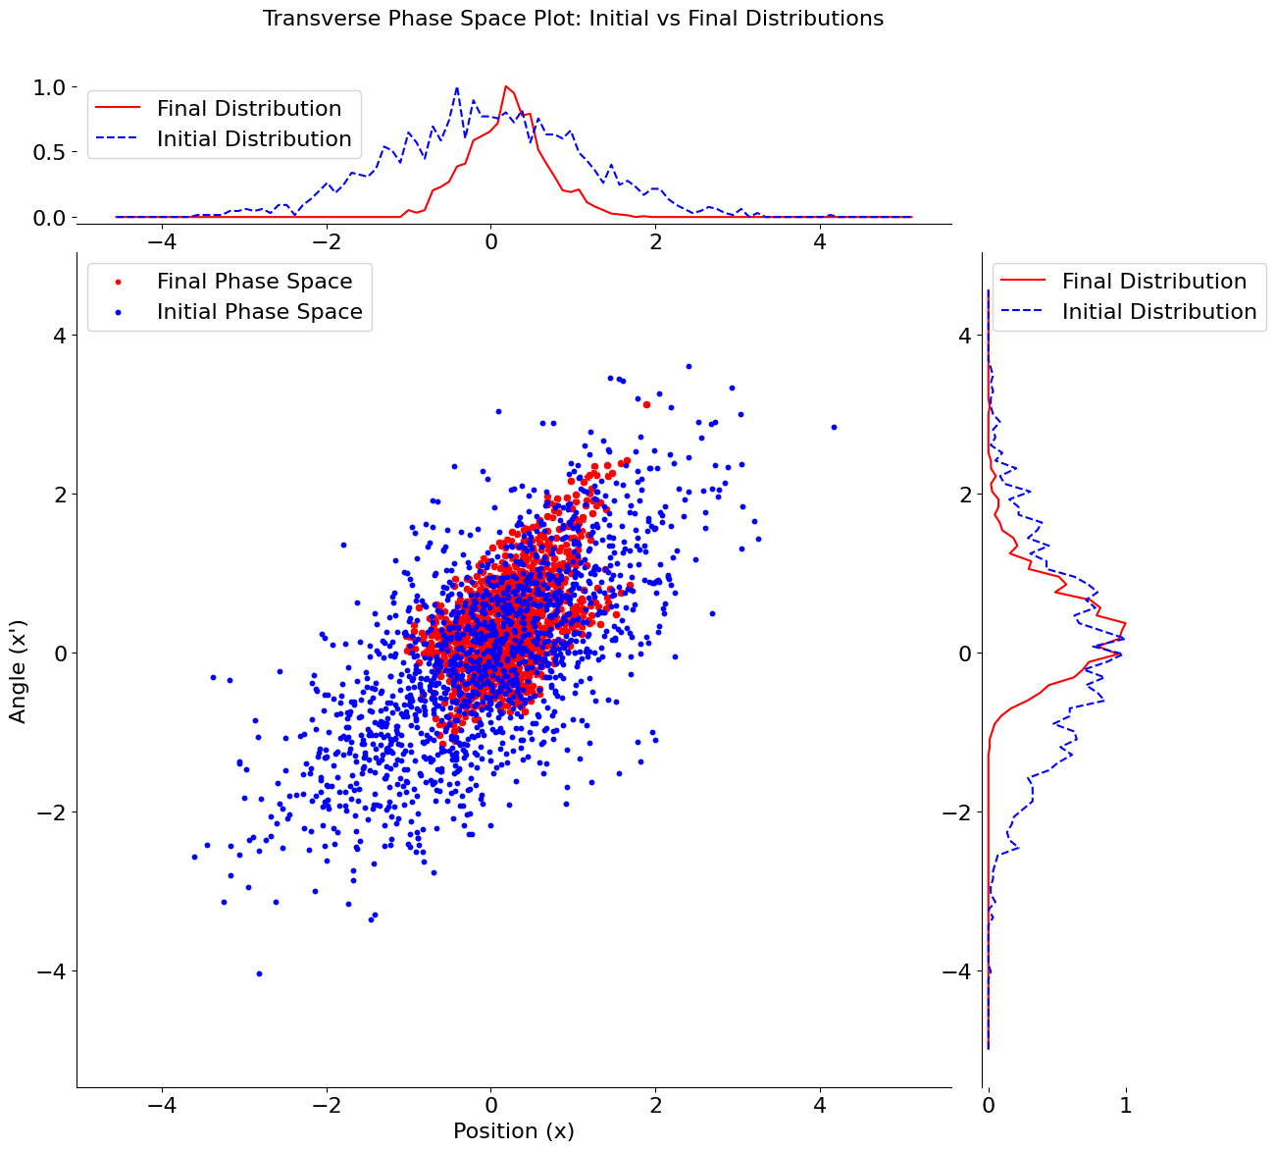
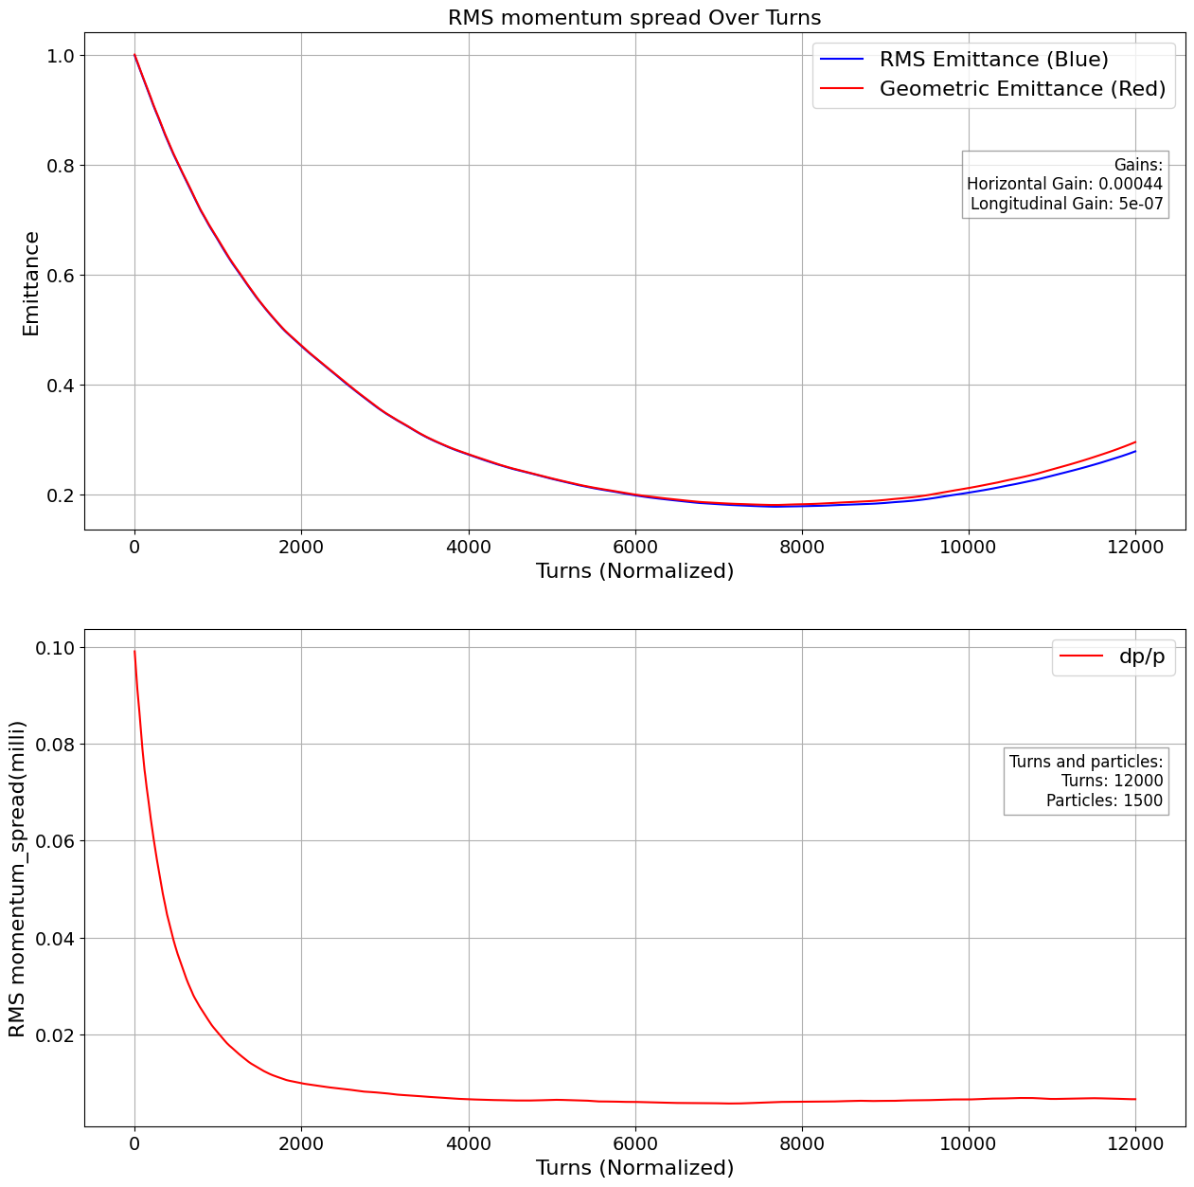
Stochastic cooling-Some results → antidamping
Antidamping case, due to large transverse gain!
Transverse Gain = 4.4e-04, Longitudinal gain= 5e-07, turns=12000, particles=1500

Slide 9
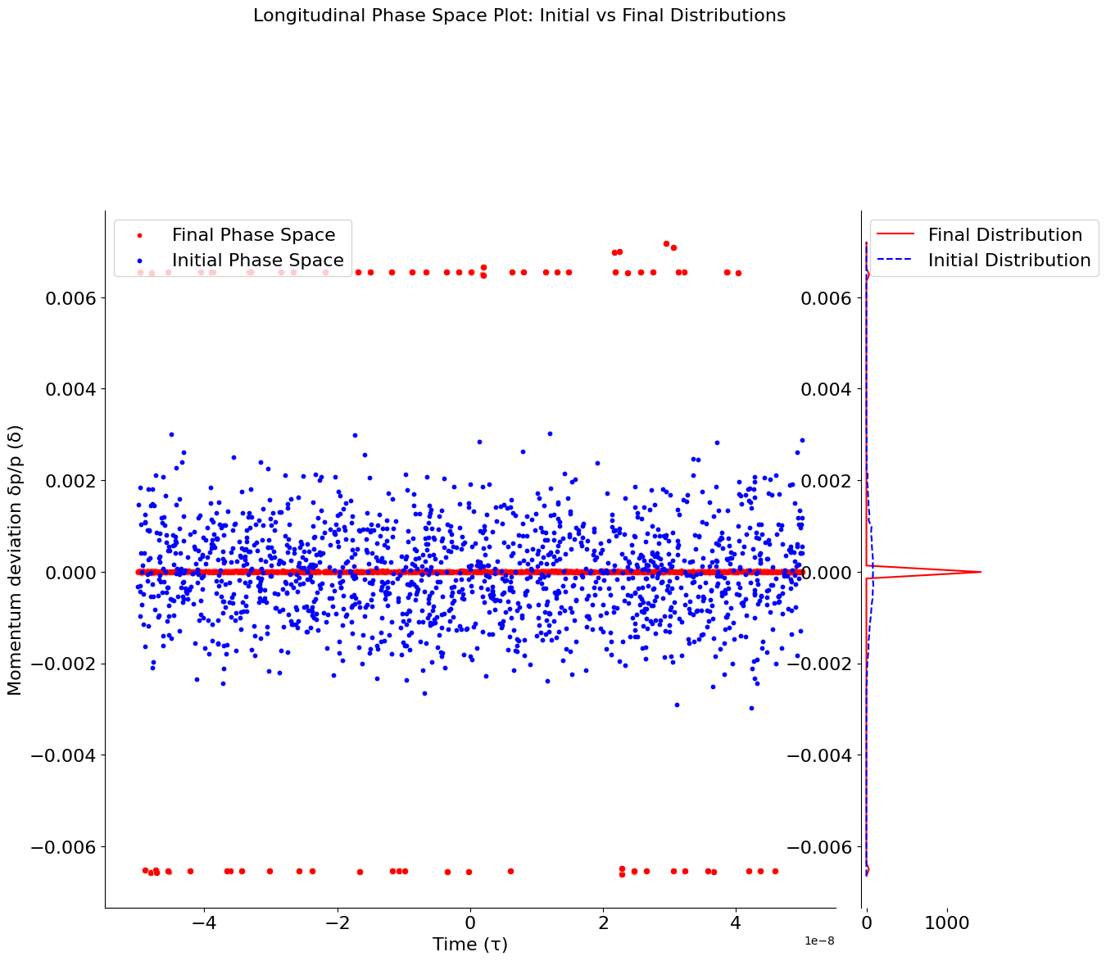
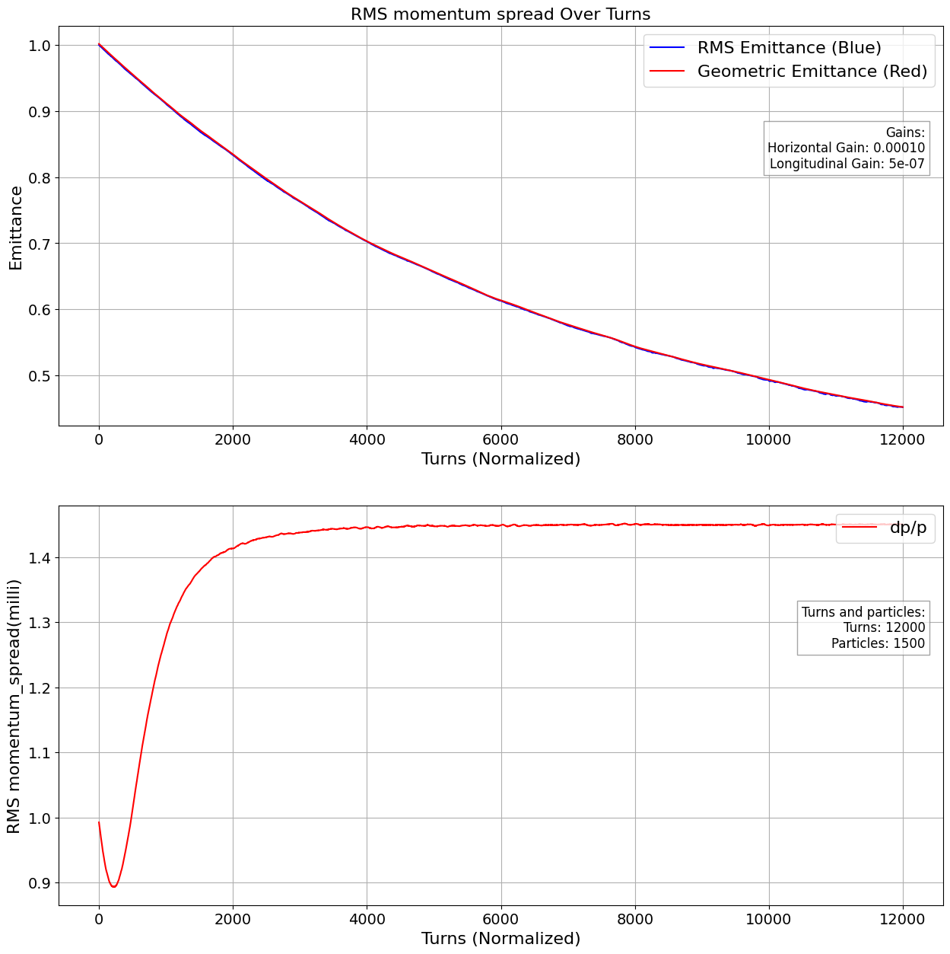
Stochastic cooling-Some results → 3 lines
Large momentum spread (10⁻³) leads to entrapment of particles into stable regions of zero correction
(zero points on response function). Reducing the momentum spread (10⁻⁴) resolved this issue!
Transverse Gain = e-04, Longitudinal gain= 5e-07, turns=12000, particles=1500 dp/p=0.001

Slide 10
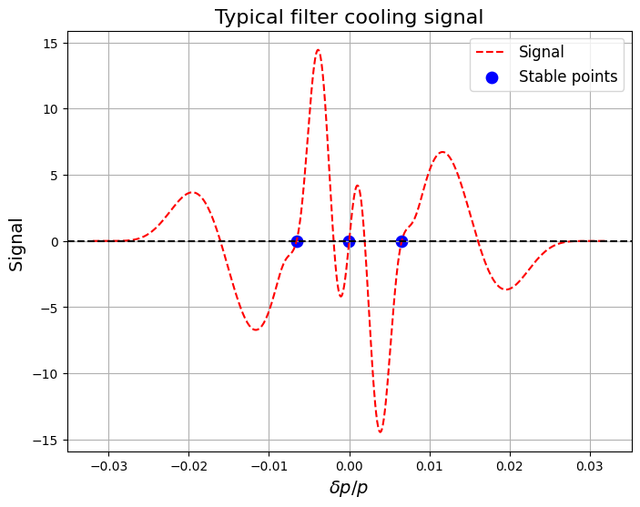
Stochastic cooling-Some results → 3 lines(b)
Particles with the ‘right’ dp/p are ‘trapped’ in this region, receiving kicks that are placing them back to the equilibrium point of the signal!!
Signal=Signalprevious_turn-signalcurrent_turn
Stable regions of the signal(positive slope) at dp/p = -6.57e-03, 0, 6.5e-03

Slide 11
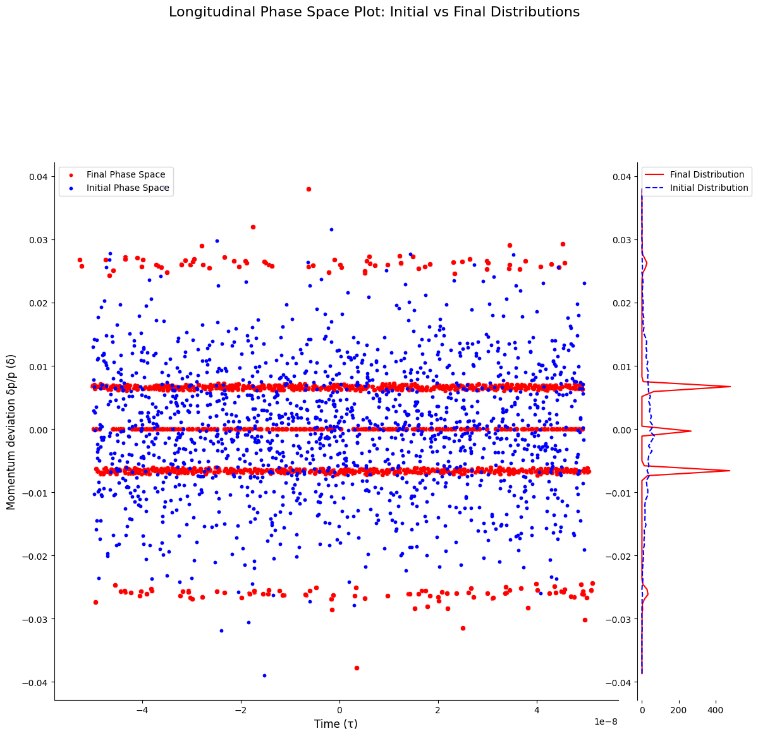
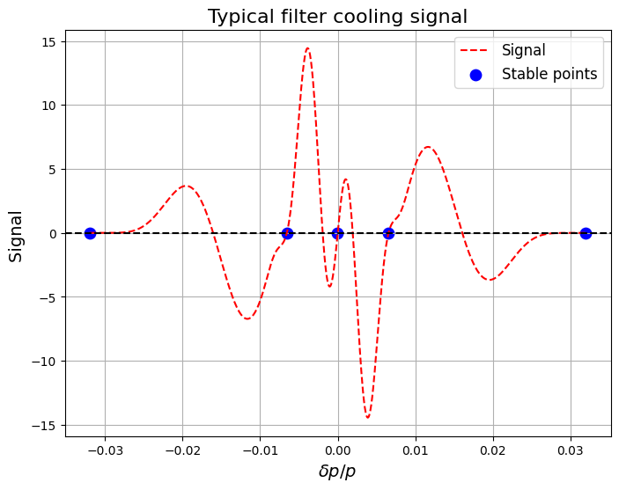
Stochastic cooling-Some results → 5 lines
Particles with the ‘right’ dp/p are ‘trapped’ in this region, receiving kicks that are placing them back to the equilibrium point of the signal!! The particles at the edges are receiving no kick at all!
Signal=Signalprevious_turn-signalcurrent_turn
dp/p=0.1
Even larger!!!
Stable regions of the signal(positive slope) at dp/p = -3.2e-2,-6.57e-03, 0, 6.5e-03,3.19e-2

Slide 12
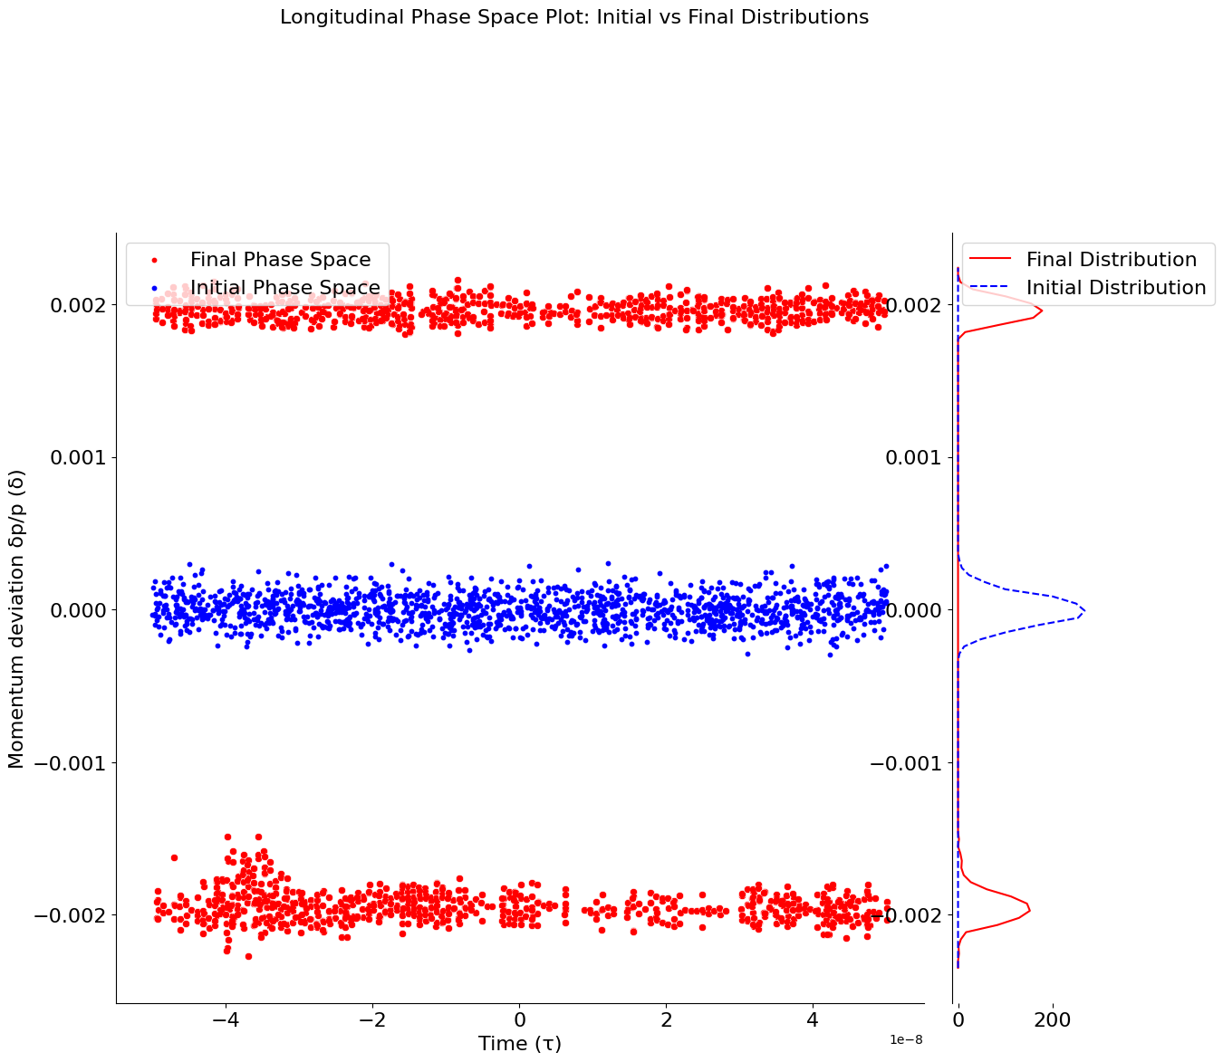
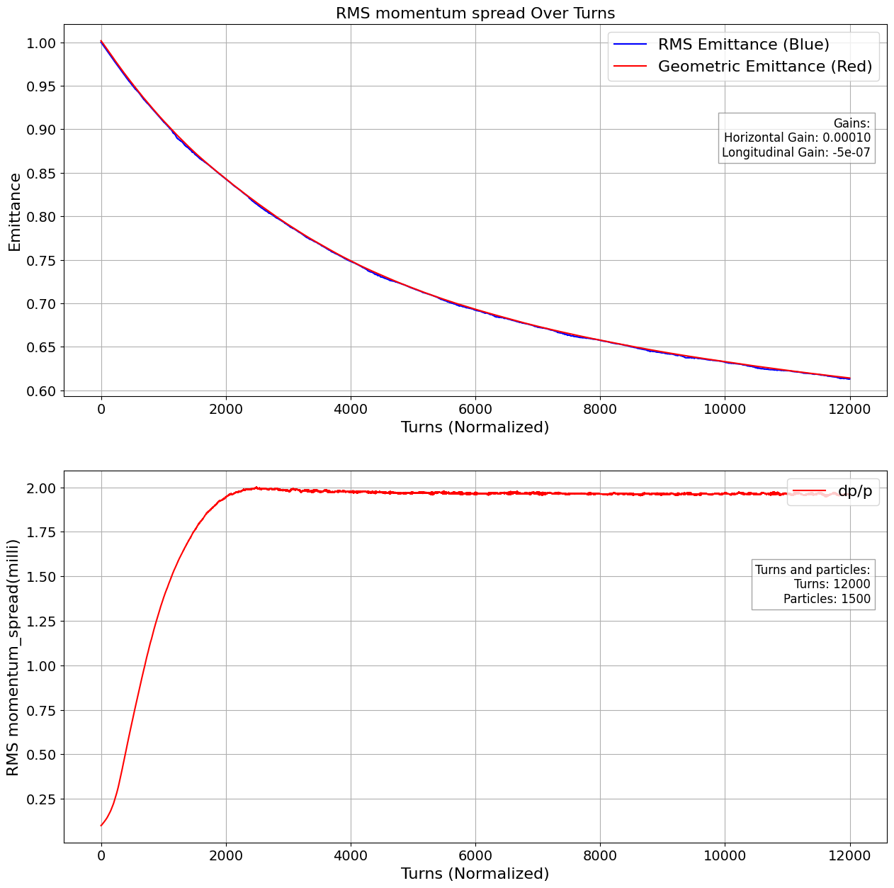
Stochastic cooling-Some results → 2 lines
Opposite sign of longitudinal gain leads to entrapment of particles into stable regions of zero correction
(zero points on response function). As we see, this leads to increace of rms momentum spread.
Transverse Gain = e-04, Longitudinal gain= -5e-07, turns=12000, particles=1500

Slide 13
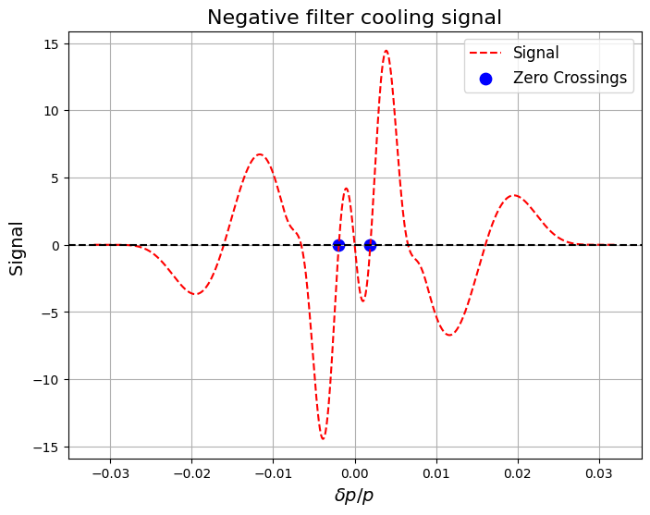
Stochastic cooling-Some results → 2 lines(b)
Particles with the ‘right’ dp/p are ‘trapped’ in this region, receiving kicks that are placing them back to the equilibrium point of the signal!! The particles at the edges are receiving no kick at all!
Signal=Signalprevious_turn-signalcurrent_turn
Here the gain has opposite sign, hence this signal!!! Now the stable regions are different!
Stable regions of the signal(positive slope) at
dp/p=-1.95e-03, 1.89e-03

Slide 14
Stochastic cooling- Improvements
Electronic noise to be added
FFT spectral analysis on time traces
Response functions to be discussed → more accurate representations on response functions
Kick correction → From discrete convolution to continuous convolution → speeding up simulations
Implementation on Xsuite
Apply on AD

Slide 15
Thank you!

